Slide 1

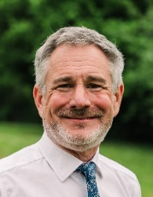
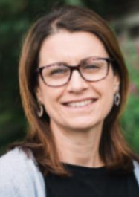
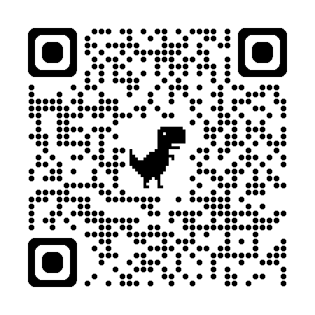
Sandford School & Nursery Newsletter Friday 20th March 2026
Mr Jolliffe
Executive Principal
Mrs Fee
Head of School
On Thursday afternoons over the last four weeks our Years 5 and 6 pupils have had the opportunity to talk to leaders from different religions and beliefs. All nine schools have taken part in the talks and have learned more about the beliefs, celebrations and daily lives of Hindus, Sikhs, Pagans and Humanists. I have been really impressed with the quality of the children’s questions and the thought-provoking comments that they have made. This shows a real deepening understanding of belief systems from around the world and I have really enjoyed facilitating the talks week by week.
PRAYER ROOM
Every half term, a group of parents meet to pray for the federation schools. The next prayer room will be on Friday, 27th March at 9.30am at Silverton Evangelical Church [School Road, Silverton EX5 4JH]. Please contact Andy Mathers [apmathers@gmail.com] for more information.
YEAR 3 and 4 RESIDENTIAL VISIT
There is now more information about the staff who are going to be going on the residential visit to Dartmoor Zoo on the EVMF website, and can viewed by following this link: https://www.exevalleyfederation.co.uk/Year-3-4-Residential/
The children were delighted on Monday to discover that our new friendship benches had arrived! These have already become a wonderful addition to both playgrounds. A huge thank you to Sandford Storytellers for making this happen so quickly. Our fundraising efforts will continue retrospectively to support this lovely project. On Tuesday, Otter and Creedy enjoyed a very special treat linked to their Geography learning. Jonathan and Gemma Stephens kindly brought in some lambs, giving the children a fantastic hands‑on opportunity to extend their understanding of farms and local agriculture. It was a memorable experience for everyone involved. After school the same day, a group of Year 3/4 pupils represented our school at a netball tournament hosted by Bow Primary School. As always, they demonstrated excellent teamwork and made us incredibly proud. On Thursday, our Year 5/6 children were joined by pupils from Brampford Speke for a practical session on map reading and compass skills, followed by a walk in the beautiful spring sunshine. This was a great introduction to outdoor navigation and a great opportunity to collaborate with another school. Looking ahead, Year 6 will be taking on the challenge of a 10‑mile training walk in Thorverton next week, preparing them for the 16‑mile Exmoor Challenge in May. Finally, on Friday, the children supported Comic Relief by wearing something red. Thank you, as always, for your generosity and support for such important causes.
EVMF PARENT SURVEY
Every year we ask parents for their views about their child’s school and we use this information to help shape our development plans for the coming year. This year, we have made a much shorter survey, with ten questions and two free text sections, in the hope that more parents will be able to contribute their views. A revised QR code is here, which takes you straight to the survey. The survey will be open until Friday, 20th March. Thank you so much.

Slide 2
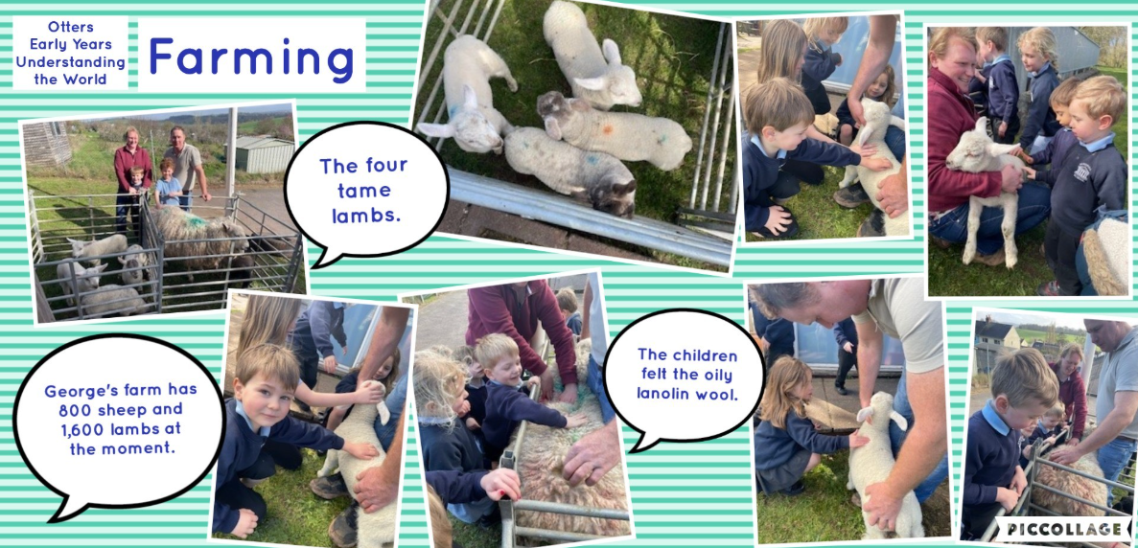
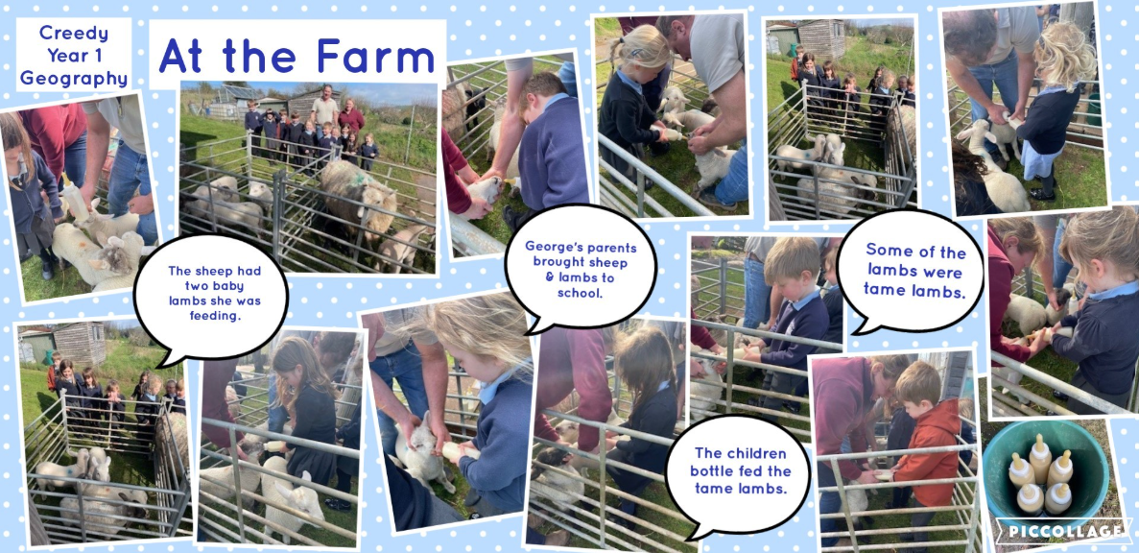
This week in school…
On a sunny Tuesday afternoon Jonathan and Gemma kindly brought in a five year old sheep with its two lambs as well as four tame lambs for the Creedy and Otter children to touch and ask questions to find out more about sheep farming. The Creedy children were fascinated and asked lots of interesting questions and found out that George’s farm has 500 steers and 800 sheep who have had about 1,600 lambs over the last few months.
The Creedy children were able to bottle feed the four tame lambs which they thoroughly enjoyed. The Otter children touched the oily lanolin wool of the lambs and sheep and watched the lambs feeding from their mother sheep. The children wondered why the sheep had lots of different colours on the wool on its back and Johnathan explained that it told him how many lambs the ewe was expecting and that the number was put on the ewe and her lambs once they were born so they could be matched up together in the field if they got separated.
We are very grateful to Gemma and Jonathan for their time at this very busy time of the year for them, and their interesting explanations to the children about sheep farming, and to the sheep and lambs for being so friendly and well behaved at school. A wonderful hands-on learning experience.

Slide 3
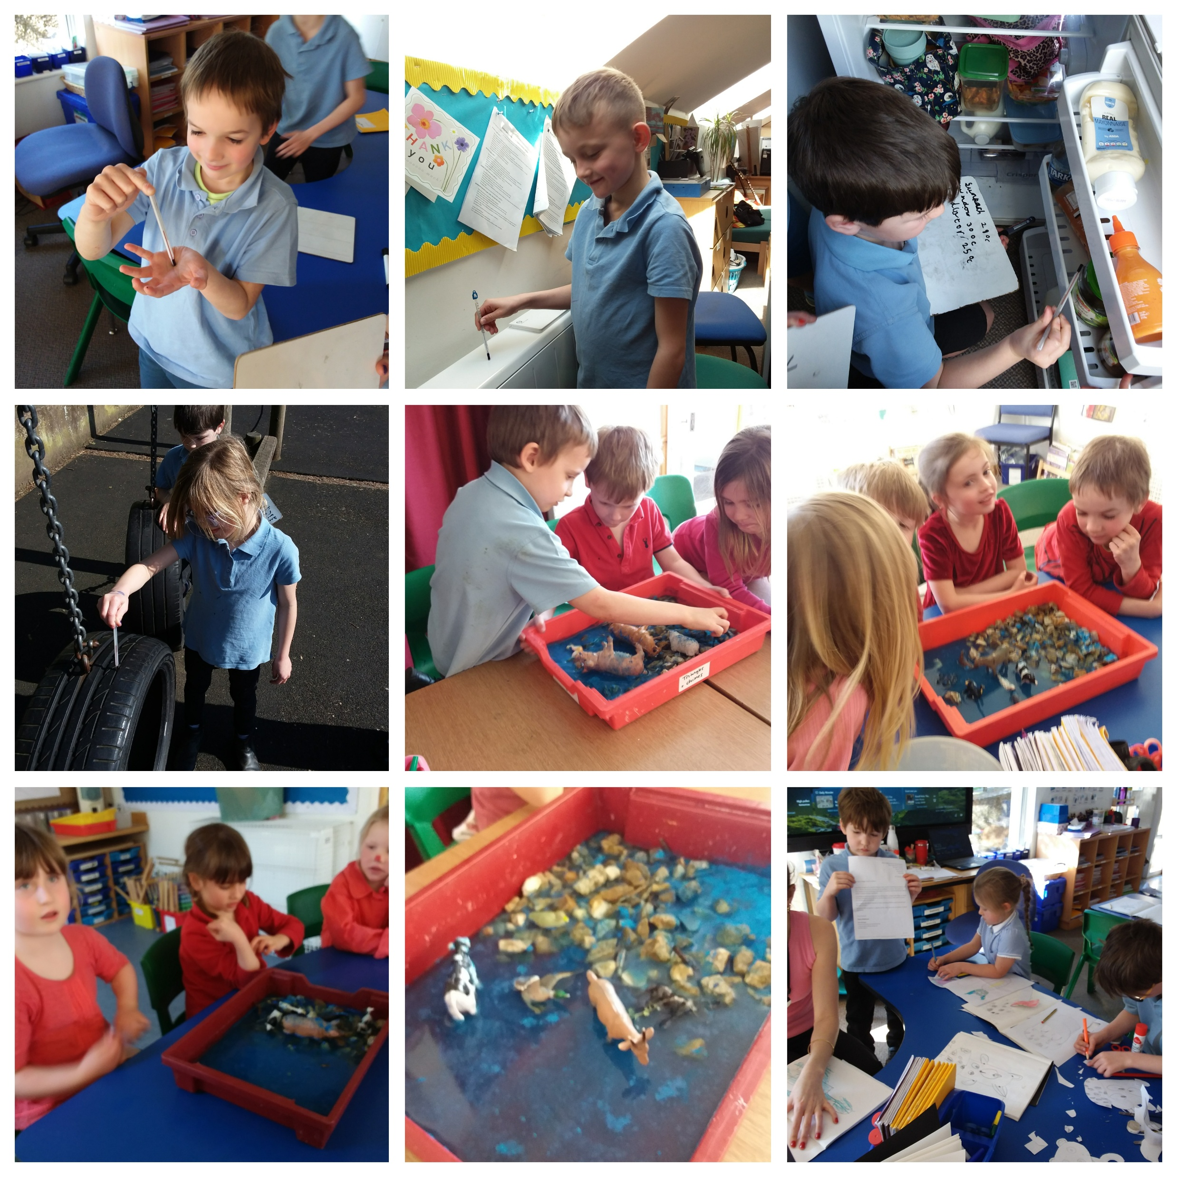
Tavy class have been enjoying the sunshine this week and have been enjoying some learning activities outside. The Year 2s have been learning about temperature and using thermometers in Maths and they had lots of fun taking the temperature in different parts of the school including the staffroom fridge! The Year 3s have been learning about fractions in Maths. The children have been enjoying their English work on Fantastic Mr Fox and the focus this week has been on punctuation. In science the Year 1 and 2s have been learning about pesticide this week and they had lots of fun doing an experiment using powder paint for the pesticide, plastic animals and watching what happens to the pesticide when it rains. P.E outside the sunshine has also been a lot more fun!

Slide 4
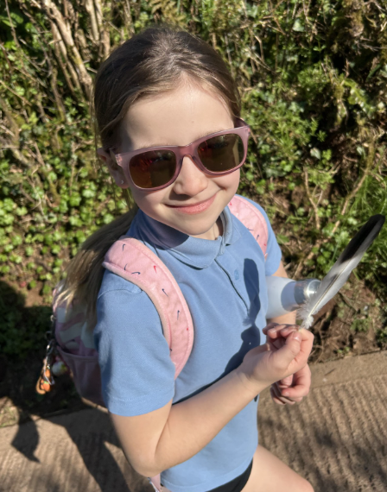
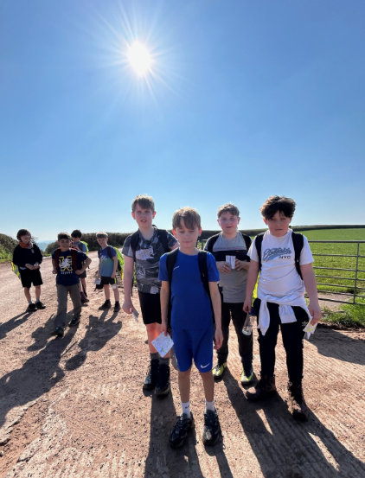
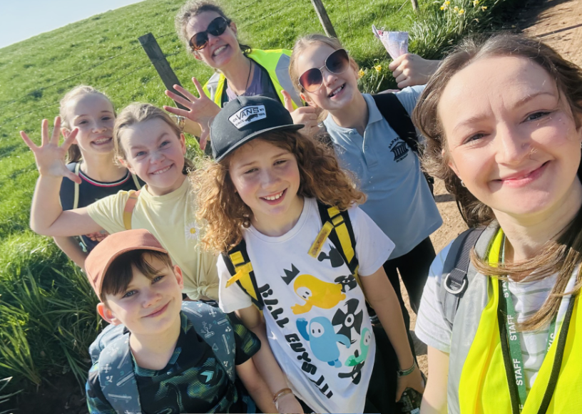
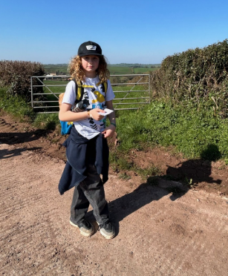
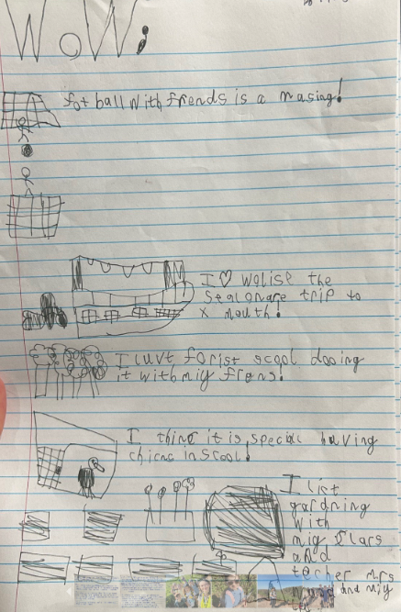
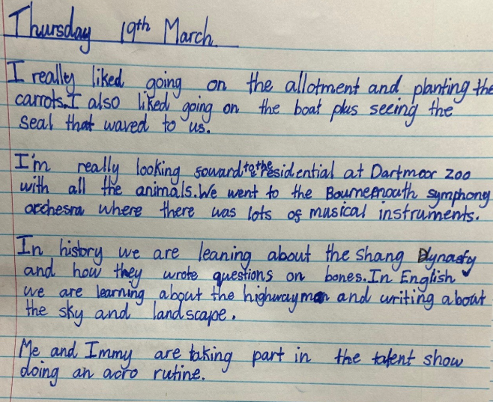
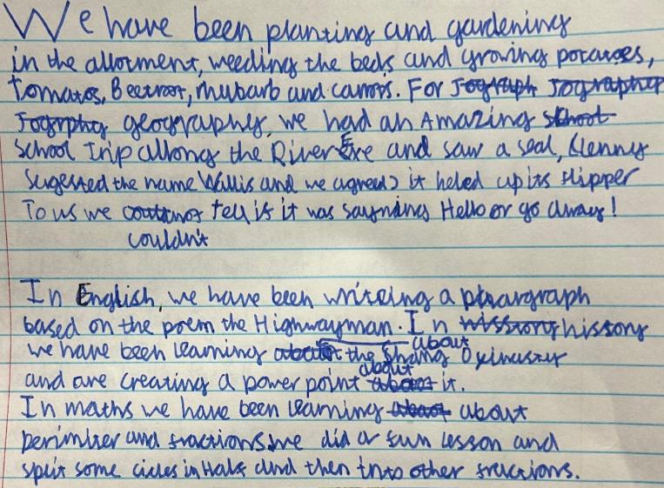
On Tuesday, our Year 6 pupils welcomed a visit from QE, helping to support a smooth and confident transition ahead of September. Later in the week, Years 5 and 6 joined children from Brampford Speke for a fantastic 8 km walk in preparation for the Exmoor Challenge, which some of our pupils will be taking part in during the summer term. Blessed with magnificent spring sunshine, the children had a wonderful time while developing their map-reading and compass skills.
Year 4 have also been working incredibly hard on their fractions this week and thoroughly enjoyed an afternoon of Forest School with Mrs Perry on Thursday. They also took time to reflect on their learning over the past few weeks and have written entries for this week’s newsletter. We hope you enjoy reading all about our Dart adventures below.
By Isaac ❤️
By Tasya ❤️
By Tom ❤️

Slide 5

Week Beginning 23rd March
 | Before School | Morning | Afternoon | After School
Monday | Sunflowers 7.45 – 8.25 Breakfast Club 8.25 - 8.45 |  | Sandford Storytellers Whole School Assembly | Bracelet and Key Chain Sale 3.30pm Sunflowers 3.30 – 5.45
Tuesday | Sunflowers 7.45 – 8.25 Breakfast Club 8.25 - 8.45 |  | Vet visit for Otter & Creedy Picture News Assembly | Sunflowers 3.30 – 5.45 Band 3.30 – 4.30
Wednesday | Sunflowers 7.45 – 8.25 Breakfast Club 8.25 - 8.45 | Tavy and Dart PE | Otter and Creedy PE | Sunflowers 3.30 – 5.45 Silent Disco with Mr Keast - 3.30 – 4.30
Thursday | Sunflowers 7.45 – 8.25 Breakfast Club 8.25 - 8.45 | Year 6 Thorverton Walk |  | Sunflowers 3.30 – 5.45
 |  | Tuck Shop | Scrum Kids Otter and Creedy
Friday | Sunflowers 7.45 – 8.25 Breakfast Club 8.25 - 8.45 | Final Sports Morning Year 3/4 Mobile Library KS1 | Celebration Assembly | Sunflowers 3.30 – 5.45 Science Club 3.30 – 4.30 Easter Bingo 6pm
Congratulations to Kai, Wilf, Gregor, Ruby, Maia and Maya who all received a Head of School award in today’s Celebration Assembly!

Slide 6
Spring Term Dates
Date | What’s happening? | Where? | Who’s involved?
Thursday 26th March | Y6 walk around Thorverton | Meet at Thorverton Memorial car park | Y6 pupils
Mon 30th March | Year 5/6 Netball Tournament | Lords Meadow | Group of Year 5/6 children
Tues 31st March 11am | Spring Talent Show | Sandford Parish Hall | All children and their families
Thurs 2nd April 2.30pm | Open Afternoon | In school | All welcome
Summer Term Dates
Date | What’s happening? | Where? | Who’s involved?
Mon 20th April 7.30pm | FOSS MEETING | Virtual | Parents/friends of Sandford School
Thurs 23rd April | Year 6 Walk | TBC | Children doing Exmoor Challenge
28th-29th April | Year 3/4 residential | Dartmoor Zoo | Year 3/4 children
Thurs 30th April AM | Devon Music Education Hub interactive concert | School | All classes
Sat 2nd May | Exmoor Challenge | Dulverton | Year 6
Tues 5th May 3.45 – 5pm | Year 5/6 Cricket | Sandford Cricket Club | Group of Y5/6 children
W/B 11th May | KS2 SATS | School | Year 6
Fri 22nd May 2pm | Guitar Assembly | School Hall | Guitar players and their parents
Fri 22nd May 2.30pm | Open Afternoon | School | All welcome
25th – 29th May | HALF TERM

Slide 7




Please do pre-book your child’s school lunch via the My Child at School app. It helps us out in the classroom and makes mornings run much smoother and quicker. If your child is off school, or has a packed lunch instead, the meal will be credited by the office so you won’t pay for a meal you don’t have. Do contact the office if you are having issues with logging in or paying for items.
Our lovely Miss Spence has been busy sorting out the second hand school uniform and, although there is still a bit of work to do, it is looking much smarter and easier to access.
Now that nowhere locally stocks school uniform it is much trickier to get replacements, so don’t buy new – come and see what we have; save a few pounds and save the planet too!
We also have a small stock of wellies if you need spares for school or home.

Slide 8

We still need a few volunteers to help out at the Easter Bingo next Friday night, such as helping serve refreshments, or setting up before or clearing up afterwards. Speak to Gemma Stephens or Abby in the office if you can help!

Slide 9



