Slide 1

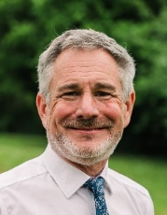
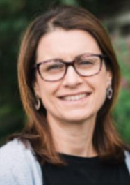
Sandford School & Nursery Newsletter Friday 22nd May ‘26
Mr Jolliffe
Executive Principal
Mrs Fee
Head of School
The Exe Valley and Moorsway Federation includes four church schools, which were built on church land in Victorian times and have kept their foundation as church schools ever since. Every five years, the schools are inspected to ensure that they are continuing to keep to their original purpose in what is known as a SIAMs inspection. Over the last year or so, all four schools have been inspected, the most recent one being Silverton this week. The six community schools benefit from the work that we do with church schools because enabling every child to flourish is equally important in all our schools.
HEAD OF SCHOOL APPOINTMENTS
We are very pleased to announce that Miss Ellie Aldridge is going to be the interim Head of School at Cornwood from September 2026. She is already well-known to the school community and will be able to have a good handover from Mrs Sheevaun Manning over the next half term. We are hugely grateful to Mrs Manning for looking after Cornwood since January and providing continuity of leadership in this time. We have also made a very good appointment at Whimple School yesterday, and will share more information with you as soon as the statutory employment checks are complete.
GOVERNOR NEWS
There have been a few changes to the governing board as we have said ‘thank you and goodbye’ to Mrs Sarah Blomley, who has finished her time as a school governor at Cornwood. Mrs Kate Wotton is going to finish as a federation governor at the end of July, and we will send out information about electing a new parent governor after half term. We are delighted that Rev Deborah Leighton Plom will be joining the federation board as a Foundation Governor, replacing Rev Paul Hinckley who is going to continue supporting Cornwood as a school governor.
SAFEGUARDING CONCERNS
If you are concerned about the safety of a child in Devon or want to speak to someone, or if you are a child worried about your own safety, you can contact Front Door (Multi-Agency Safeguarding Hub or MASH) by calling on 0345 155 1071. If a child is in immediate danger please call 999. Anyone who is concerned about a child’s safety or well-being can contact the Front Door.
If you suspect that a vulnerable adult is being abused, or you are being abused yourself and live within Devon Local Authority boundaries, please contact us by calling Adult Social Care on 0345 1551 007 (Monday to Thursday 9.00 am to 5.00 pm, Friday 9.00 am to 4.30 pm and Saturday 9.00 am to 5.00 pm).
Outside of the hours above or on bank holidays call the Emergency Duty Service on 0345 6000 388.
Alternatively, you can email: safeguardingadultseast-mailbox@devon.gov.uk (Exeter, East and Mid Devon).
What a fantastic first half of the summer term we have had!
Our Year 3 and 4 children thoroughly enjoyed their recent residential visit to the zoo. The feedback from children, parents and staff has been overwhelmingly positive, and it is clear that a wonderful time was had by all. We are also incredibly proud of our Year 6 children, who approached their end of Key Stage 2 assessments with maturity and determination. They worked exceptionally hard throughout the week and should feel very proud of their efforts. Across the school, other classes have also been completing their end-of-year assessments, which will continue after the half term break. Sporting opportunities have been in full swing, with children taking part in a range of tournaments. As always, Sandford children have demonstrated excellent teamwork, resilience and sportsmanship, representing the school brilliantly. This half term has also seen us welcome new children into our school community, while saying farewell to others as they move on to new adventures. We wish them every success in their next steps.
The second half of the summer term is always a busy and exciting time. We have a wide range of trips, sporting events, performances, celebrations and transition activities planned. Please do keep an eye on the dates section of the newsletter each week so that you don’t miss anything.
With the weather forecast looking bright and sunny, it is set to be a lovely half term break. We hope you all enjoy the sunshine and some well-deserved rest, and we look forward to welcoming everyone back to school on Monday 1st June.
FEDERATION VALUE: LOVE
Next term, our focus value is Love. We will be exploring how we can demonstrate love through giving our time and energy to helping others or our communities. We will also be thinking about how we can test how generous we are being by thinking about whether we are being as good to others as we are to ourselves. This reflects the golden rule of ‘love your neighbour as yourself.’ We will explore this further by hearing the story of Johnny Appleseed, one of the best known American legends. One way to think about showing love is to remember the words of Frank A Clark, “Real generosity is doing something nice for someone who will never find out.”

Slide 2
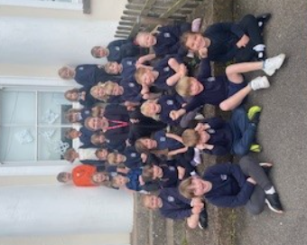
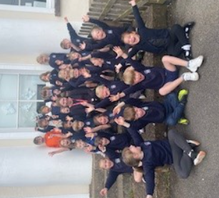
This week in school…
As we come to the end of the first half of the summer term, we would like to say ‘Congratulations’ to Maddie Chiverton for completing her T Level Technical Qualification Education and Early Years at Exeter College. Maddie has been doing her school based experience on Wednesdays and Thursdays in Otter class for most of this academic year. She has been so kind, supportive and diligent with the Early Years children and has grown in experience during the time she has been based in the classroom. We are very grateful for all her hard work with the children and know they will miss her greatly when she does leave our school. We wish Maddie huge success and enjoyment in her future career in Early Years.
Some messages from the children to Maddie….
‘I like when I do sentence writing with Maddie because I like writing things.’
‘I like her reading stories to me because she makes it fun.’
‘I like Maddie playing with me and my friends. She helps me make things.’
‘Maddie helps me build things like a sunflower. She gave me a seed and I put in the soil and it will turn into a sunflower.’
This week we have carried out phonics assessments with the Reception and Year One children and we are delighted with the good progress they are making with their reading and writing. Thank you so much for your great support with this important learning at home, it makes such a difference to their quick confident recall of all the graphemes, digraphs and trigraphs they are learning and how to blend these together for reading, and segment them for spelling. Please do continue to enjoy picture books at home too. Thank you again for your super support.
We wish you all an enjoyable half term week. The weather forecast looks like it will be warmer and drier, so fingers crossed.
The themes for next half term are ‘A Ticket to Ride’ for the Early Years children, and for the Year One’s it is a history focus ‘Seaside Holidays in the Past’. We will be increasing the amount of transition activities and opportunities for all the children to get them ready for their new academic year in September, and new year groups. We look forward to welcoming you back for the final half term of this academic year on Monday 1st June.

Slide 3
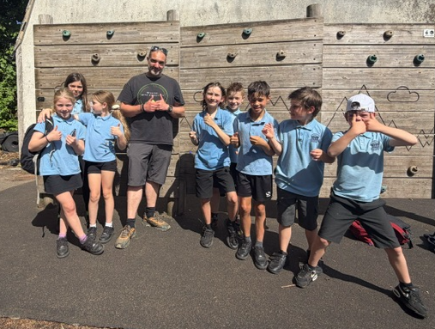
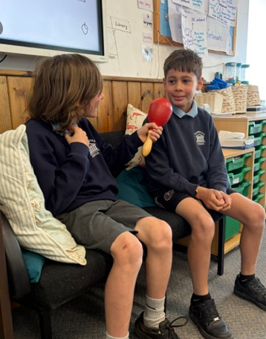
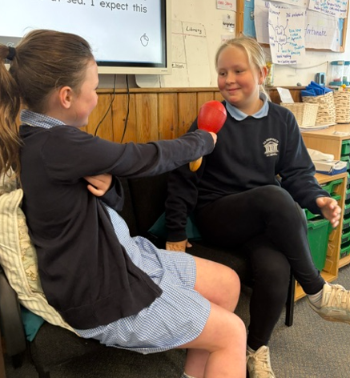
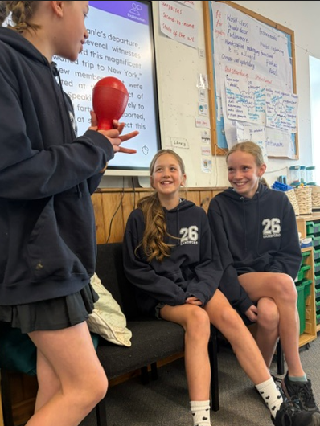
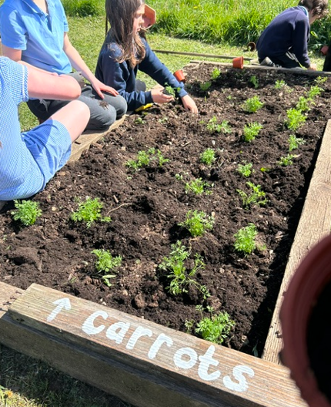
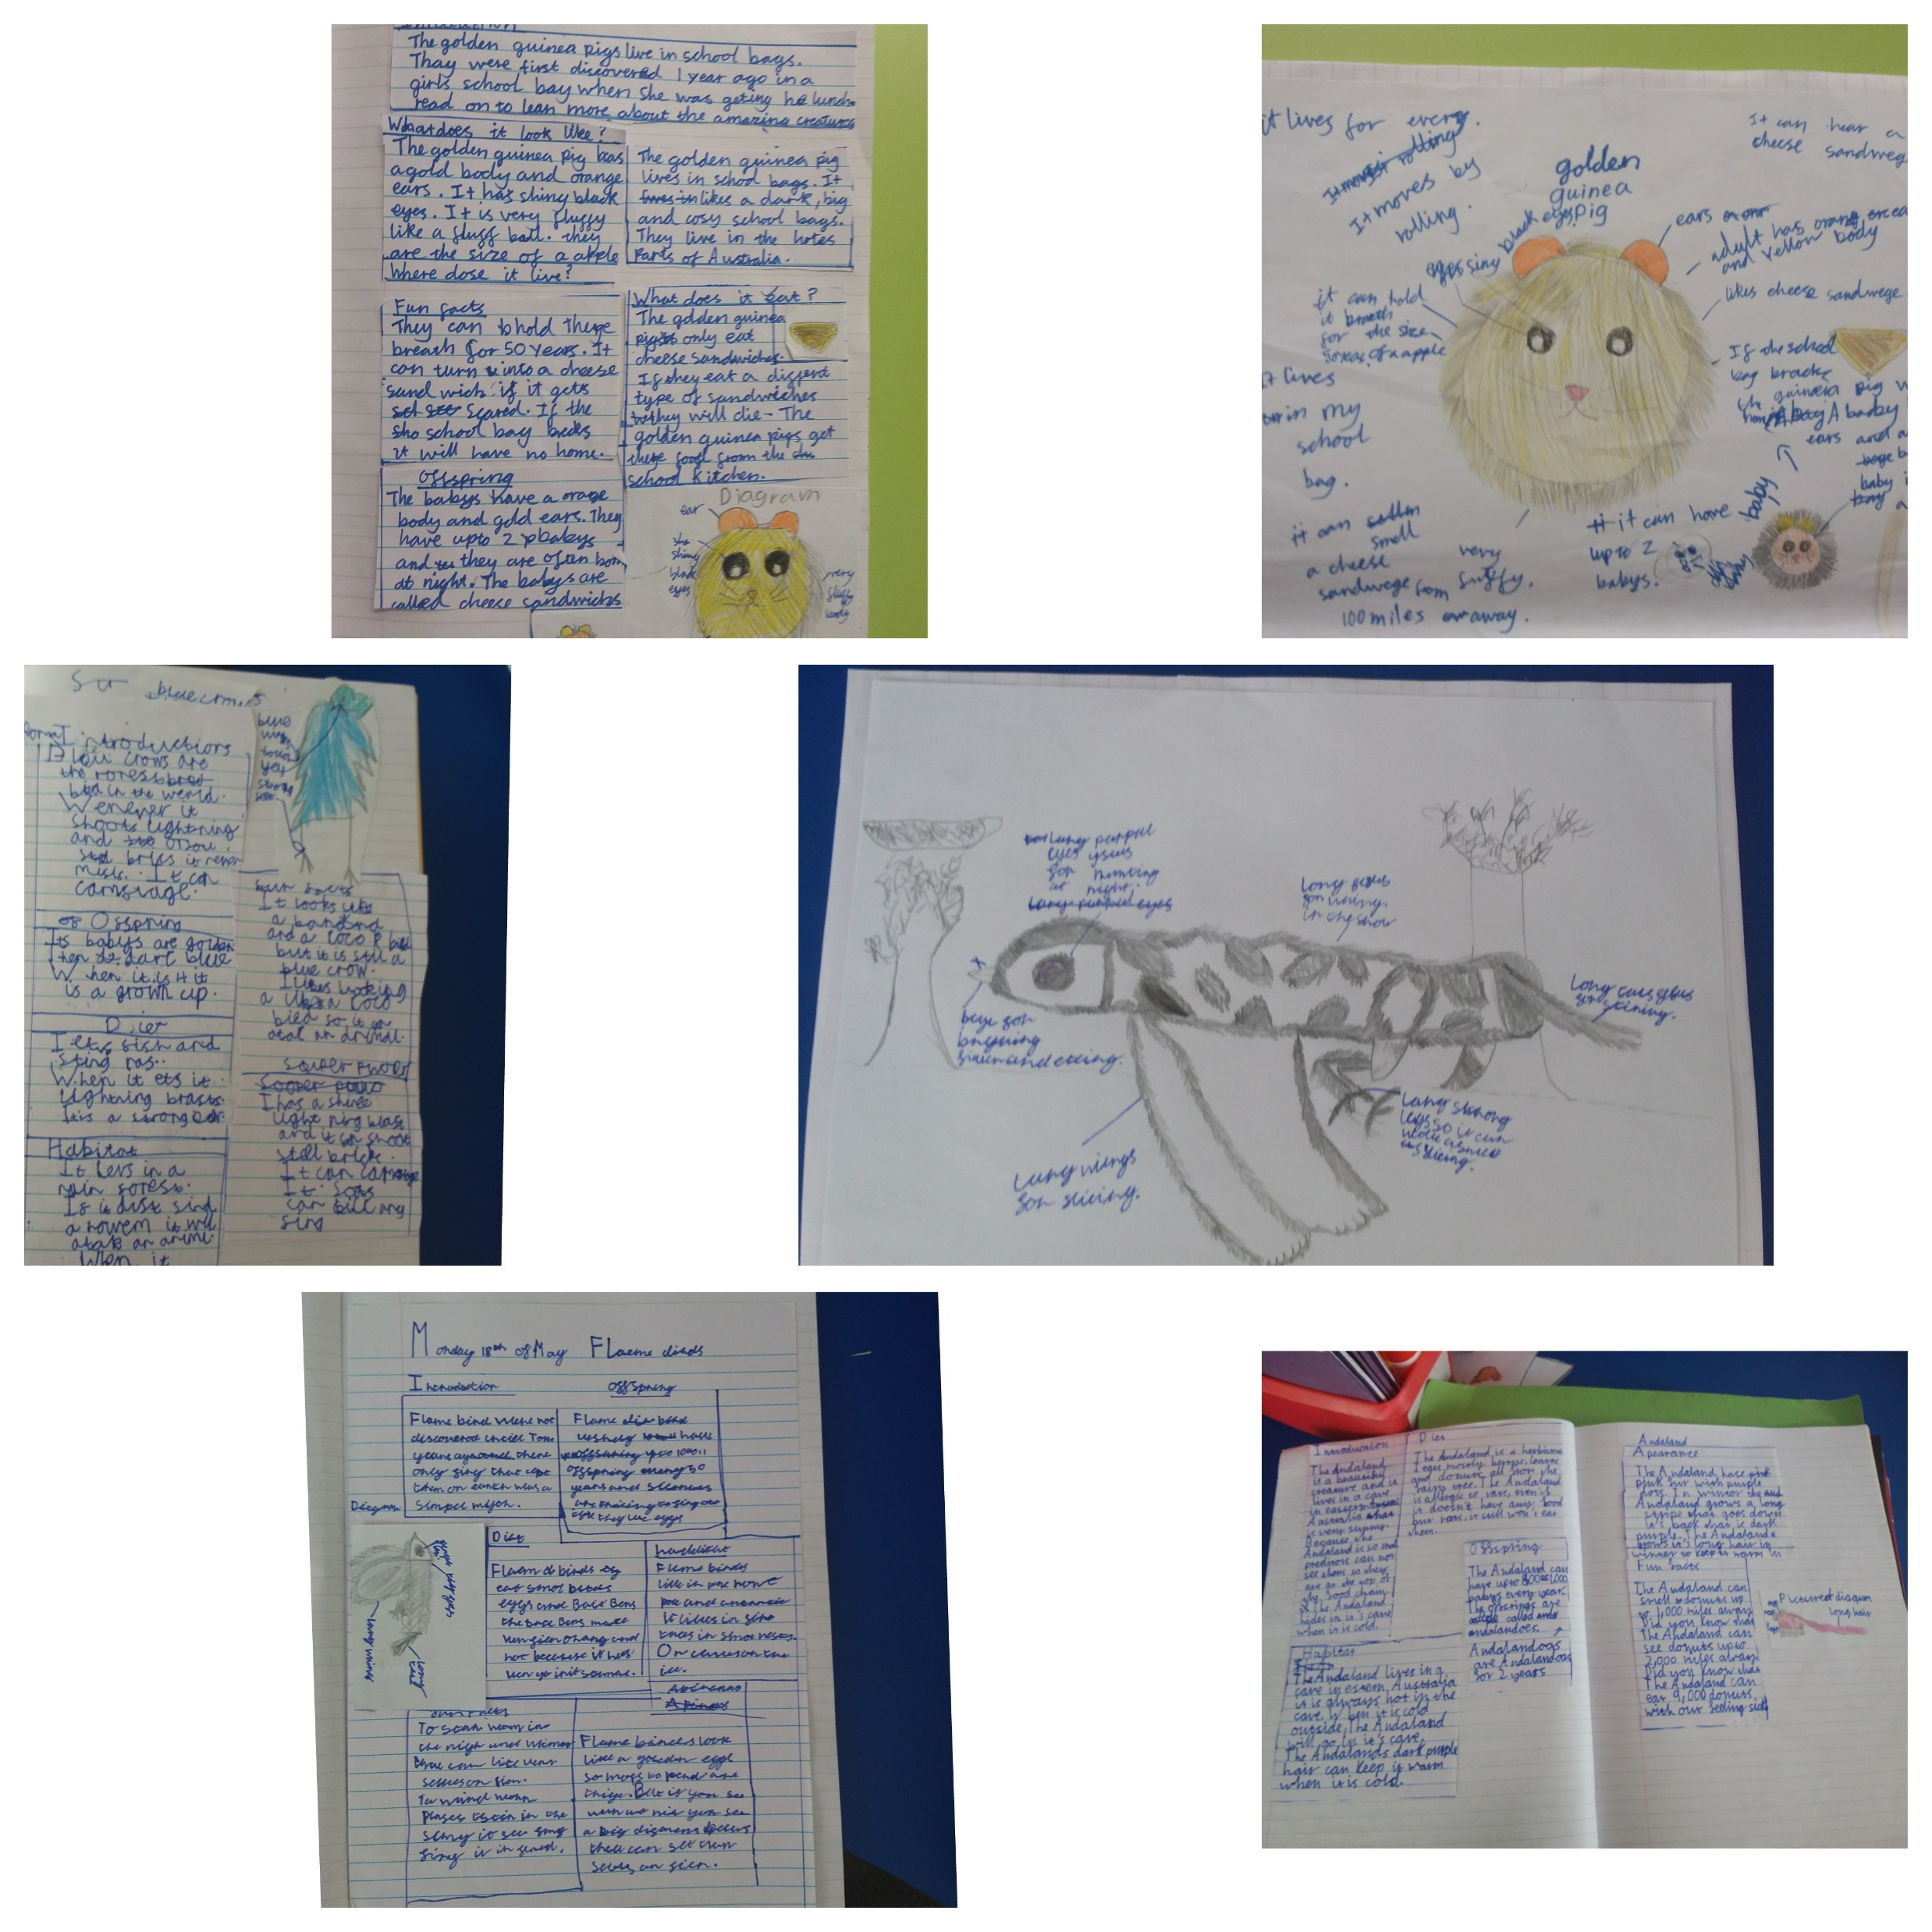
We’ve had a lovely final week of the half term in Dart Class. In English, the children enjoyed stepping into different roles as they interviewed Captain Edward Smith (captain of the Titanic), along with bystanders on the quayside as the ship set sail on her maiden voyage. It was wonderful to see their creativity and enthusiasm bring history to life.
On Thursday, some of the class spent the afternoon taking part in outdoor learning with Mr Couzens. With the sun shining, the children had a fantastic time exploring, learning, and getting wonderfully grubby!
Next half term, we are excited to get stuck into preparations for our end-of-year play, but for now, enjoy a well-earned rest!
Tavy class have been enjoying some non-fiction books in English including Moth. They have been inventing their own creatures and they have spent time drawing and labelling diagrams and writing and answering questions about them. The children have learnt about the layout of non-fiction texts and the children planned their own non-fiction page for their invented animal. You can see some photos of their final pieces which they carefully wrote up and laid out as their final draft.

Slide 4
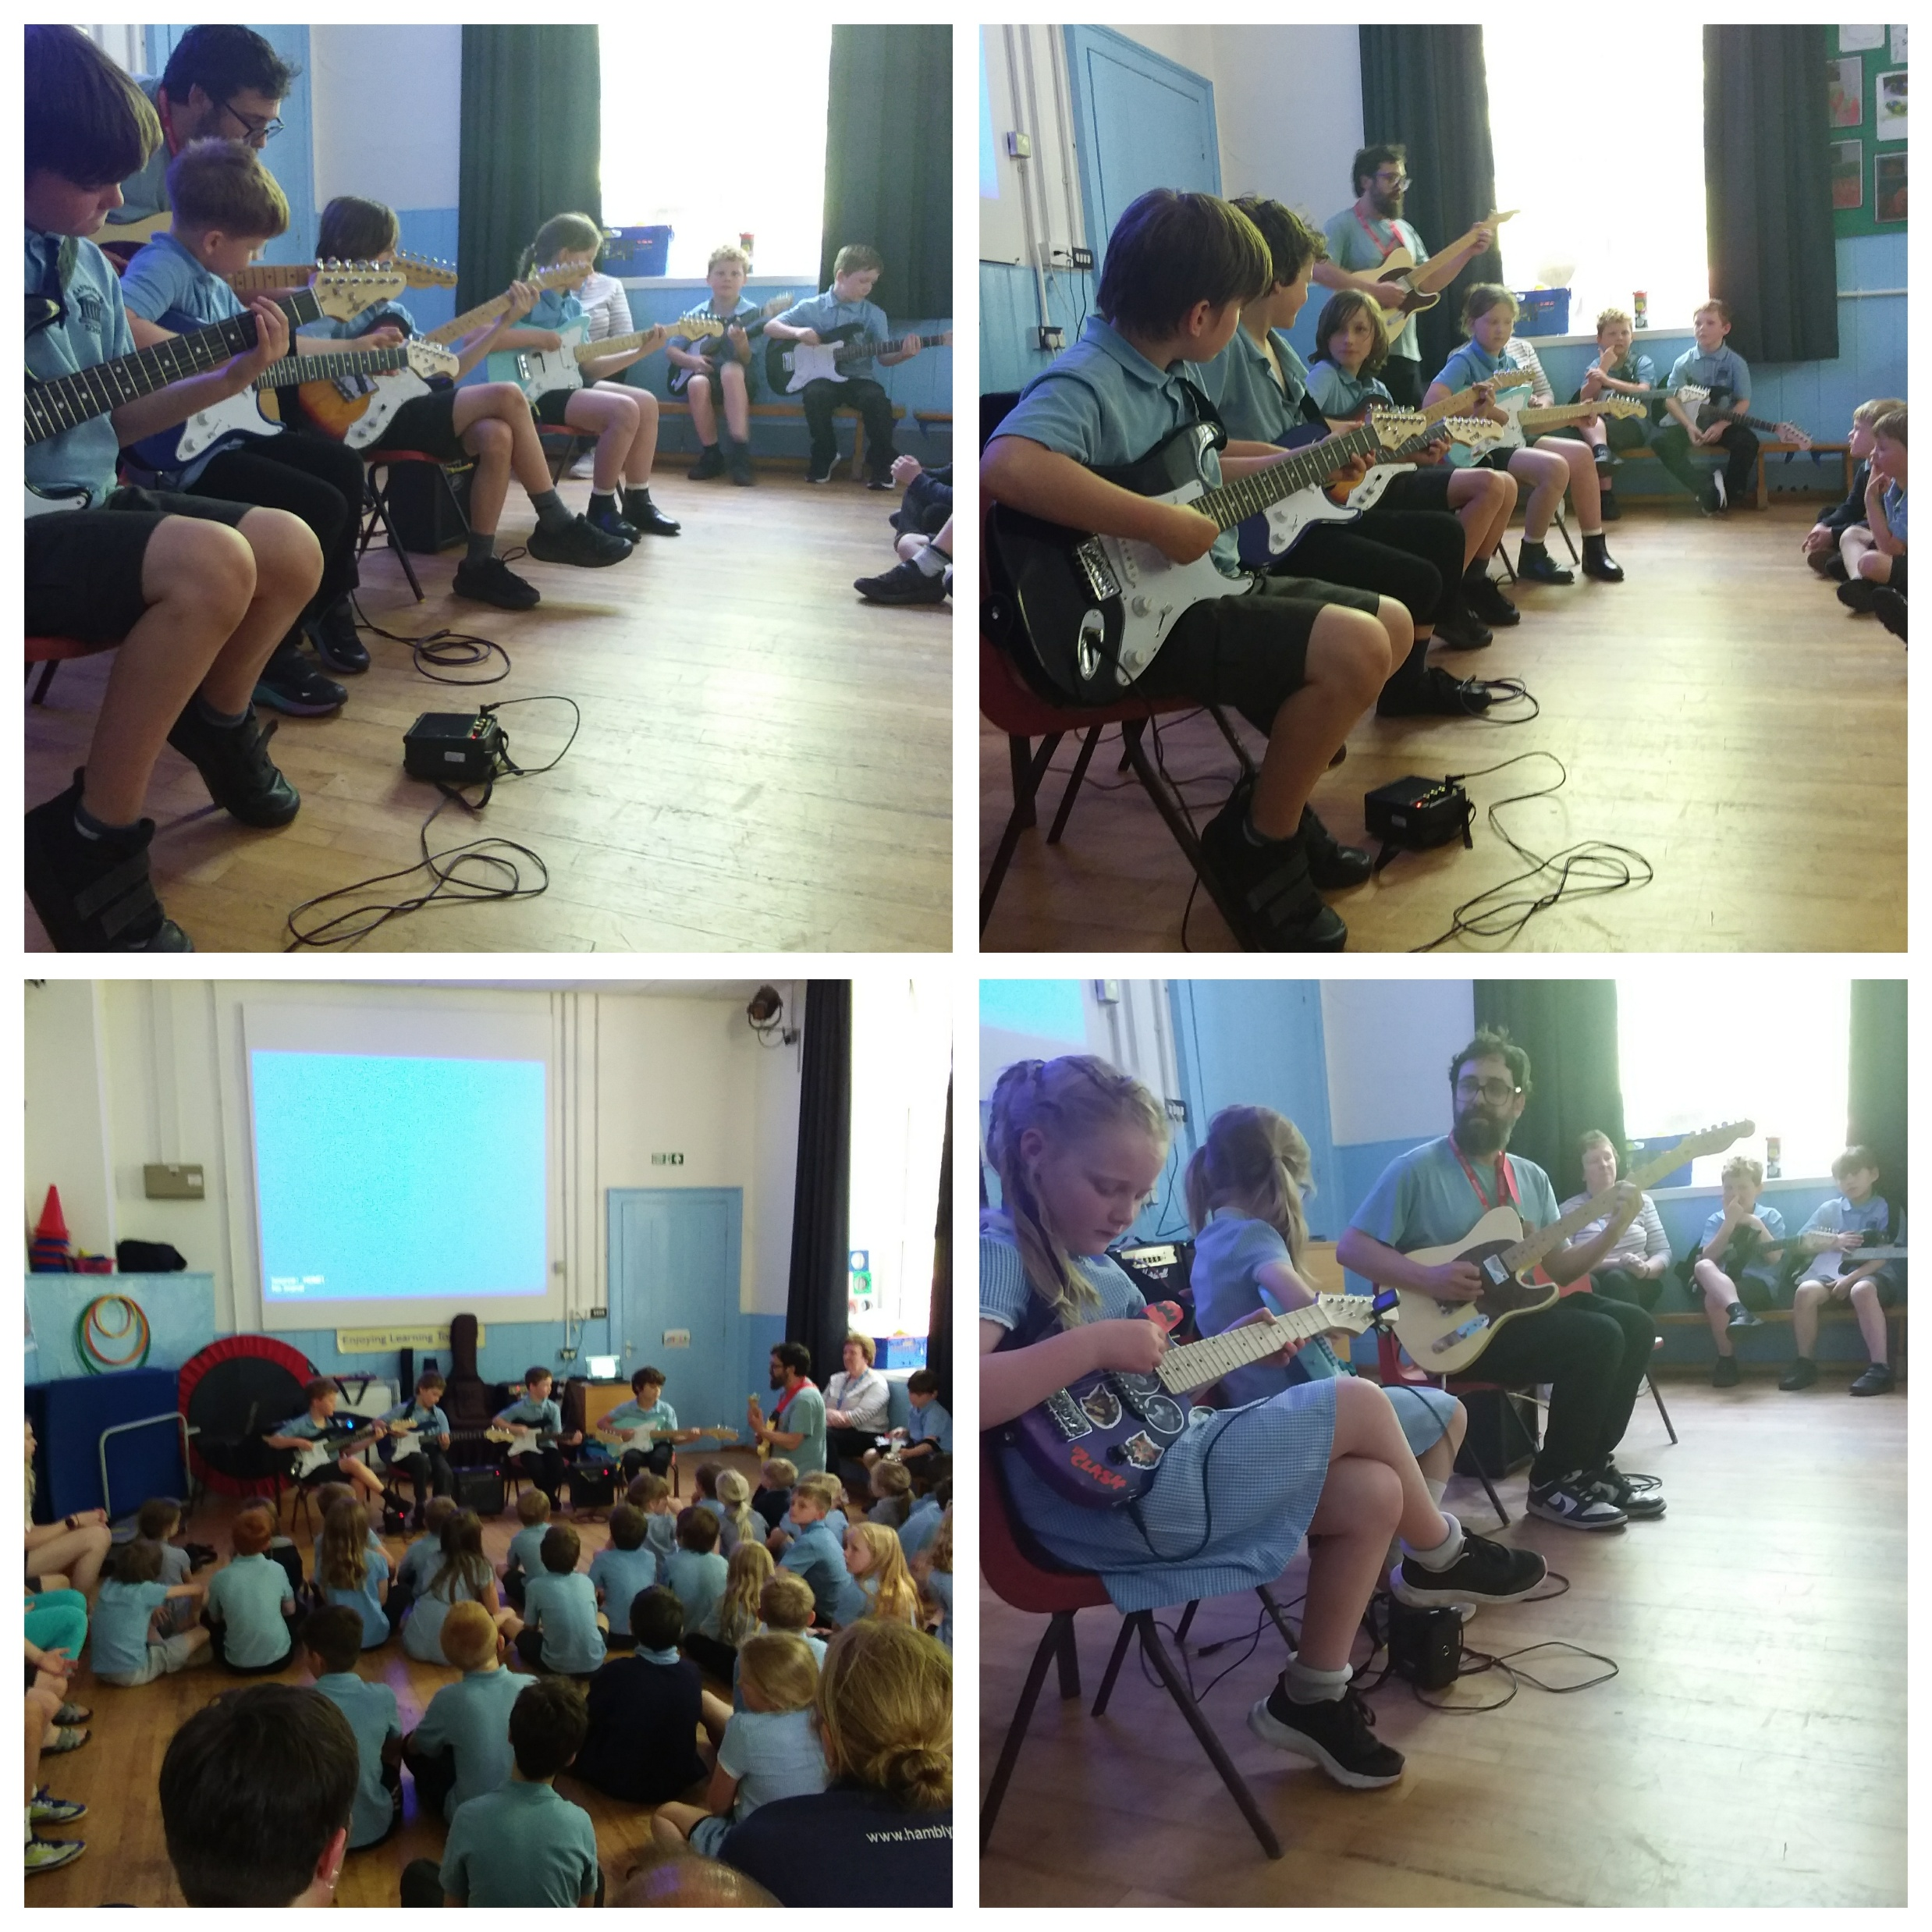
Well done to our guitarists who put on a fantastic assembly for their parents and the rest of the school this afternoon. Some of the younger children have only been playing for a couple of terms, so it’s lovely to see how much improvement they have made.
A big thank you to Sam for arranging this, as we love being able to show-case all the musical talent at our school!

Slide 5
Week Beginning 1st June
 | Before School | Morning | Afternoon | After School
Monday | Sunflowers 7.45 – 8.25 Breakfast Club 8.25 - 8.45 |  | Whole School Assembly
Tuesday | Sunflowers 7.45 – 8.25 Breakfast Club 8.25 - 8.45 |  | Picture News Assembly | Sunflowers 3.30 – 5.45 Elastic Band 3.30 – 4.30
Wednesday | Sunflowers 7.45 – 8.25 Breakfast Club 8.25 - 8.45 | Tavy and Dart PE | Otter and Creedy PE Singing Assembly | Sunflowers 3.30 – 5.45 Cricket & Rounders 3.3 – 4.30
Thursday | Sunflowers 7.45 – 8.25 Breakfast Club 8.25 - 8.45 | Tuck Shop |  | Sunflowers 3.30 – 5.45 Year 3 & 4 Football Tournament @ NSC 3:45pm – 5:30pm
Friday | Sunflowers 7.45 – 8.25 Breakfast Club 8.25 - 8.45 |  | Celebration Assembly | Sunflowers 3.30 – 5.45

Slide 6
Summer Term Dates
Date | What’s happening? | Where? | Who’s involved?
25th – 29th May | HALF TERM
Thurs 4th June 3.45 – 5.30 | Year 3 & 4 Tournament | Newton St Cyres | Group of children
Thurs 11th June 3.45 – 5.30 | Year 5 & 6 Tournament | Newton St Cyres | Group of children
Mon 1^{st –} Fri 12th June | Multiplication Tables Check | School | Year 4
Mon 8th – Fri 12th June | Phonics Screening Check | School | Year 1 (and Year 2 retakes)
WB 15th June | Year 5/6 Residential | Bath and Bristol | Year 5/6 children
Friday 19th June | Non Uniform Day in exchange for a hamper prize for Strawberry Fair! |  | Whole School
Tues 23rd June | Quogwarts | QE | Year 5
Thurs 25th June | West Hub Celebration Day | Sandford | Year 6 children from West Hub schools
Fri 26th June | Staff Development Day
Tues 30th June | Athletics Event | Landscore Primary School | Representatives from across the school
Sat 4th July | Strawberry Fair | School field | All welcome
Mon 13th July 1.30pm | Dart Show | Parish Hall | All welcome
Mon 13th July 6pm | Dart Show | Parish Hall | All welcome
Weds 15th July | Sports Day | School field | All welcome
Thurs 16th July | Teddy Bear's Picnic | School | New Reception starters + families
Fri 10th July | Reports go home |  | All children
Fri 17th July | Cross Country Event | Blundell’s | Representatives from across the school
Tues 21st July | Oscars Evening | TBC | Year 6
Wed 22nd July AM | Year 6 Leavers’ Assembly | School | Whole school and parents of Year 6
Wed 22nd July | LAST DAY OF TERM

Slide 7


Slide 8


Slide 9


EYFS Outdoor Area
We are really excited to let you know that our application for the Tesco Grants Programme has been successful and our project will be put forward to the customer vote in Crediton Tesco Stores from Tuesday 28th April.
If we win the highest number of votes we will receive £1500 to go towards our project, which is to renovate our Early years outside area.
Please encourage your friends and family to pop a token into the voting unit when they are in store. Our project is live until the end of July and we will find out the outcome in early September.

Slide 10
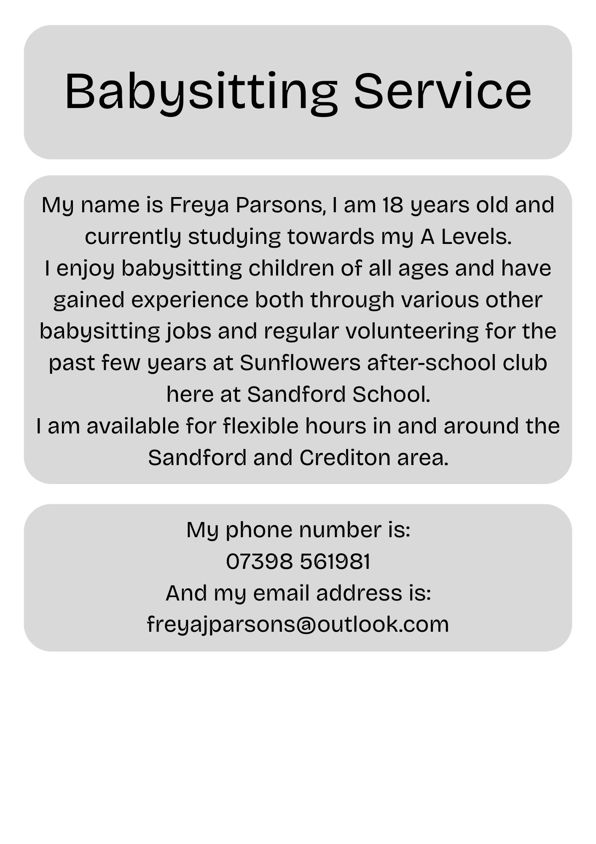



Slide 11



We’re excited to share Cosmic Creations, our latest Kick Start Art project!
Click the link below to discover creative ideas, helpful resources, and an inspiring online gallery of children’s artwork. We’d love you to join in at home (don’t forget to save the link to your favourites/ bookmark so you can keep an eye on updates).
padlet.com/nrm9fgt5hq/kick-start-art-home-page-sclrlbpqvje67rhg

